Slide 1
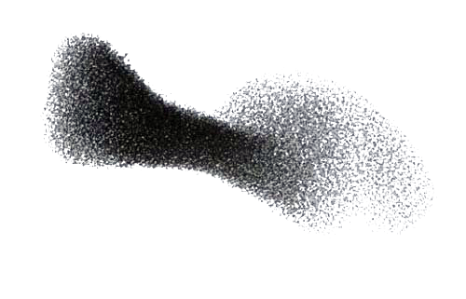
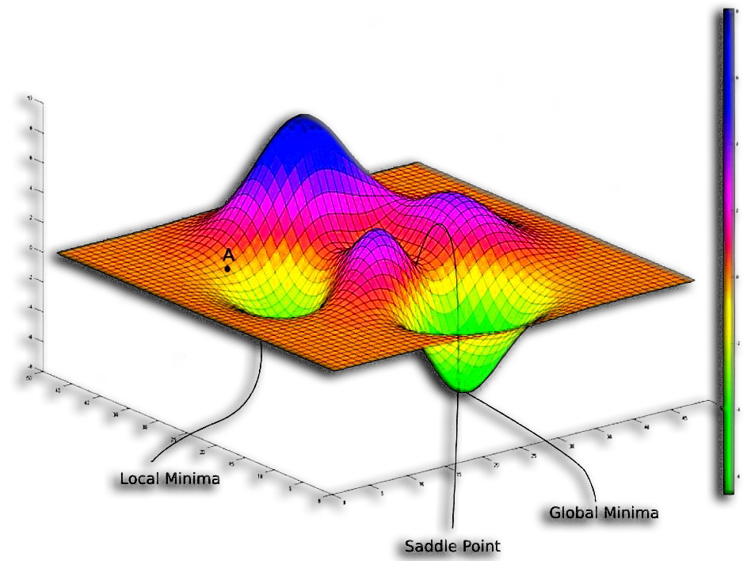
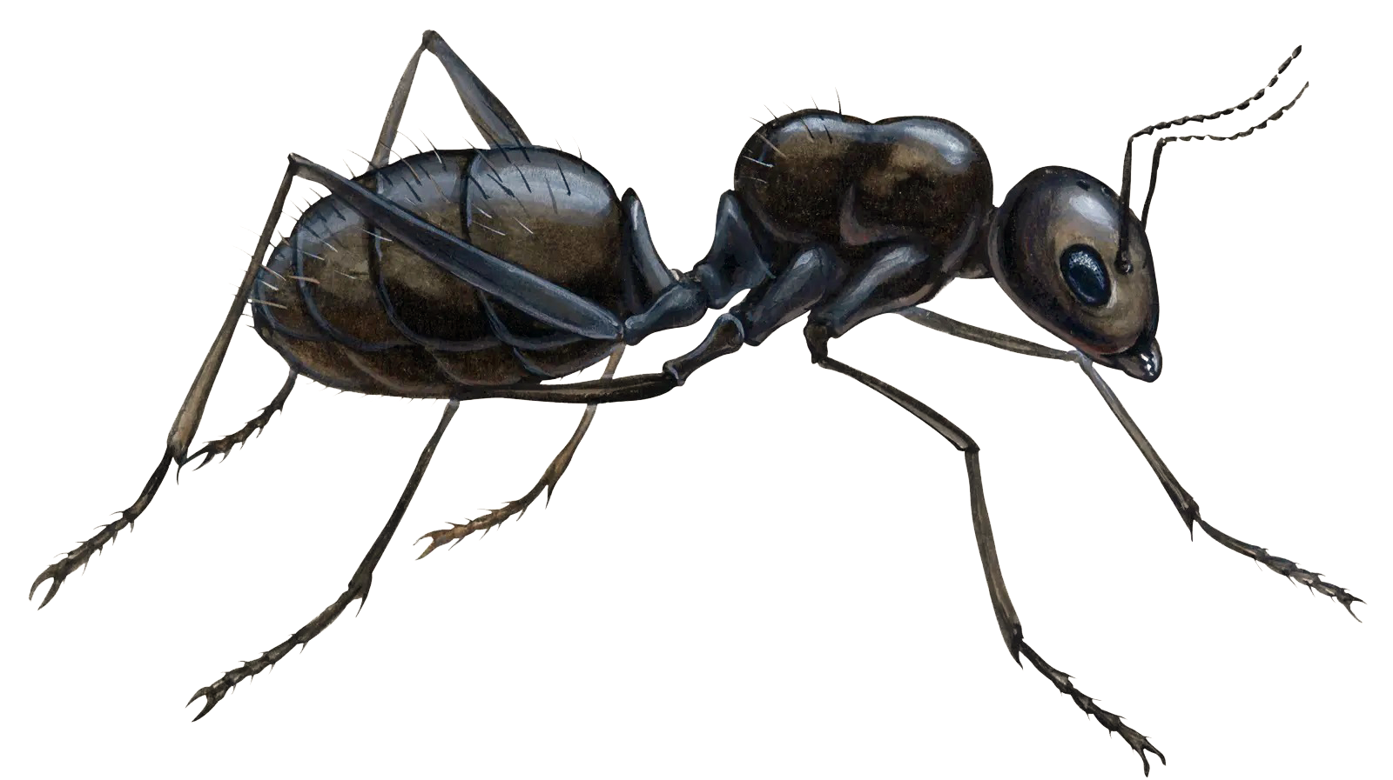
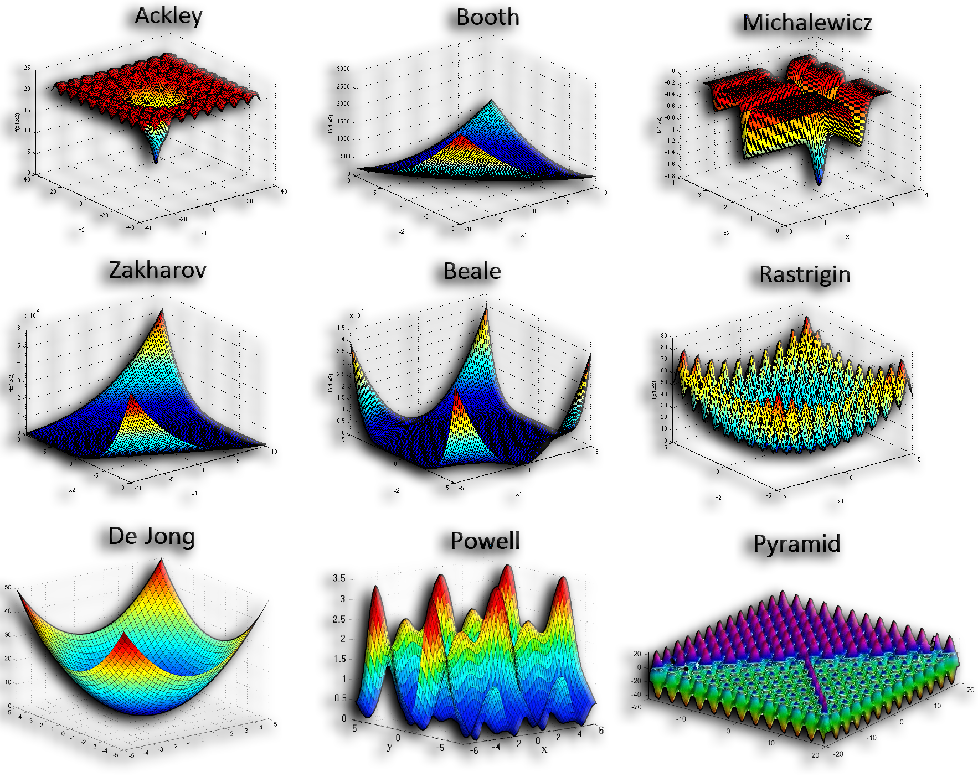
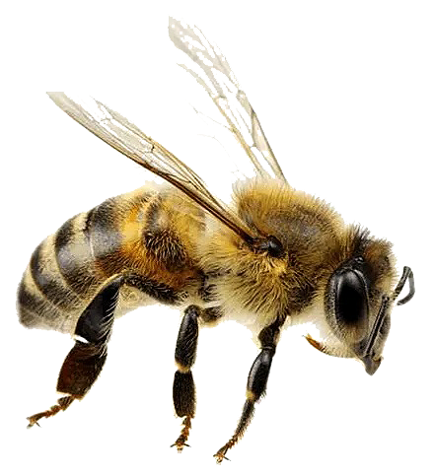

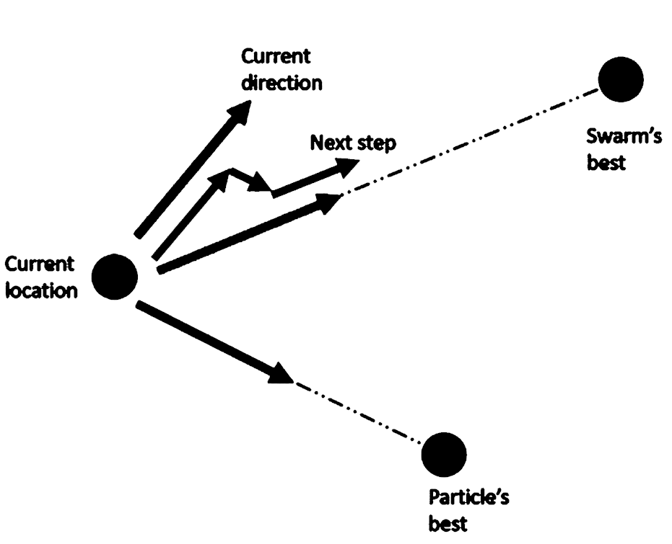
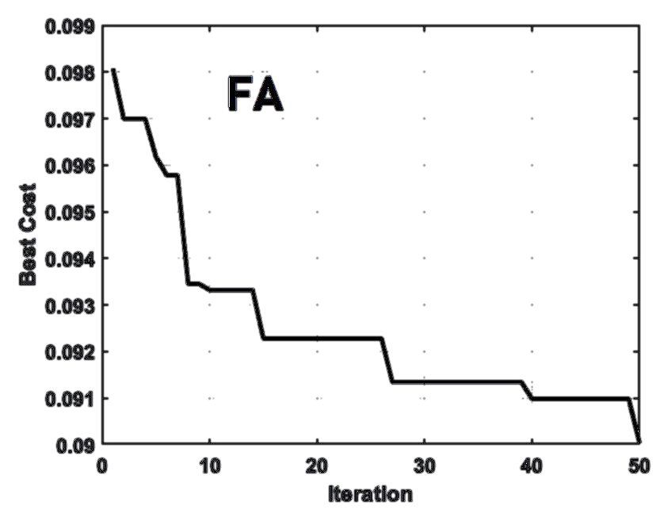

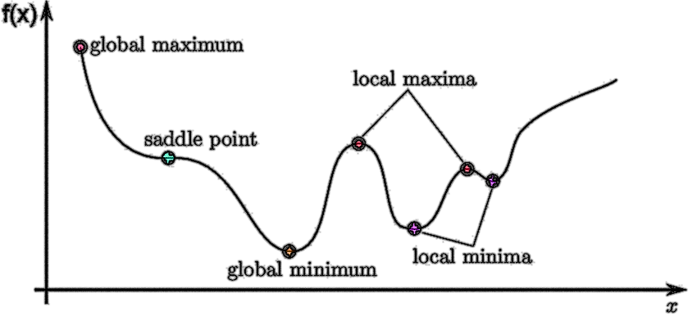

Metaheuristic Optimization: 4 Cutting-Edge Applications
Exoplanetary Adaptation Simulation by Genetic Algorithm
By: Seyed Muhammad Hossein Mousavi
2025

Slide 2


Outline:
Optimization
Optimization Problems
Protein Folding by Differential Evolution algorithm (DE)
Space-Time Warping by Firefly Algorithm (FA)
Exoplanetary Adaptation Simulation by Genetic Algorithm (GA)
Evolved Antenna Design by Particle Swarm Optimization algorithm (PSO)

Slide 3

Optimization Problems
Exoplanetary Adaptation Simulation by Genetic Algorithm (GA)
Exoplanet Adaptation: How living organisms might change or evolve to survive on planets outside our solar system.
Genetic Algorithm (GA): A computer method inspired by evolution that finds better solutions through selection, crossover, and mutation.
Population: A group of possible solutions (or genetic profiles) that compete and evolve over generations.
Generation: One full cycle of evolution where the population is evaluated, selected, crossed, and mutated.
Fitness Function: A mathematical formula that measures how well each individual survives or performs in a given environment.
The higher the fitness score, the better the adaptation.
Selection: The process of choosing the best individuals to pass their features to the next generation.
Crossover: Mixing genetic information from two parents to create new offspring with combined traits.
Mutation: Small random changes in features that keep diversity and help discover better solutions.
(For more information about GA, please refer to section one.)

Slide 4
Optimization Problems
Exoplanetary Adaptation Simulation by Genetic Algorithm (GA)
Planetary Environment: A set of natural conditions on a planet, such as gravity, temperature, radiation, and atmosphere.
Radiation Resistance: The ability of an organism to withstand harmful cosmic or solar radiation.
Bone Density: A measure of bone strength, important for surviving on planets with stronger or weaker gravity.
Oxygen Efficiency: How well an organism can use oxygen from the planet’s atmosphere to survive.
Temperature Adaptability: The capacity to live and function across extreme hot or cold conditions.
Stress Resilience: The ability to handle long days, harsh climates, or unpredictable environments.
Fitness Convergence: When evolution stabilizes and no major improvements occur, showing adaptation is nearly complete.

Slide 5
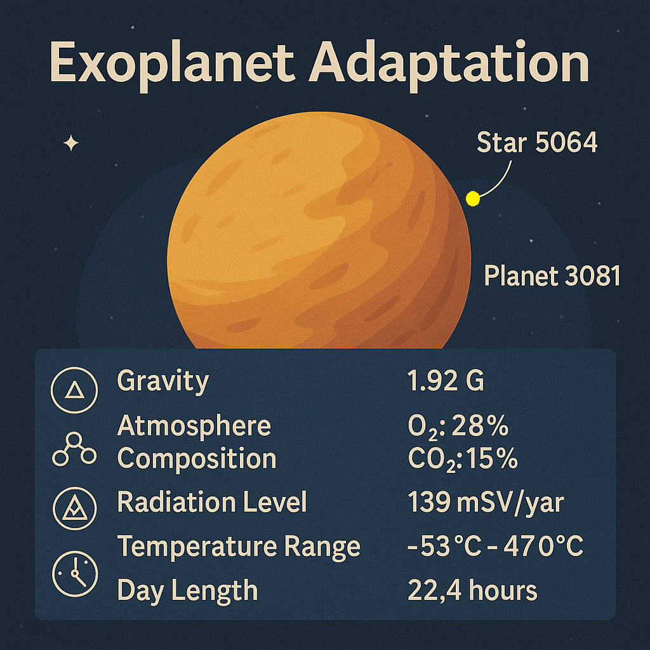
Optimization Problems
Exoplanetary Adaptation Simulation by Genetic Algorithm (GA)
High gravity → needs high bone density
Low oxygen → needs high oxygen efficiency
Strong radiation → needs high radiation resistance
Extreme temperature range → needs high temperature adaptability
Long or stressful day cycles → needs high stress resilience

Slide 6
Optimization Problems
Exoplanetary Adaptation Simulation by Genetic Algorithm (GA)
Objective Function:
GA tries to maximize this fitness function, that is, to find the genetic profile that produces the highest survival score under that planet’s environment.
The genetic profile values come from the randomly generated population in each simulation.
For example:
1. Radiation resistance: higher is better when radiation level is high.
2. Bone density: ideal when it matches the planet’s gravity (too low = weak, too high = wasteful).
3. Oxygen efficiency: good if it matches available O₂ in the atmosphere.
4. Temperature adaptability: good when average temperature approximately equal to (≈) adaptability range.
5. Stress resilience: better for long or extreme day lengths.
Example in simulation: [1=0.67, 2=4.54, 3=5.00, 4=4.77, 5=4.98]. Range is [0 to 5]
We are not comparing it with Earth’s rules as it is meaningless.

Slide 7
Optimization Problems
Exoplanetary Adaptation Simulation by Genetic Algorithm (GA)
Objective Function:
0.25 % * radiation fitness weight
0.20 % * gravity fitness weight
0.25 % * oxygen fitness weight
0.20 % * temperature fitness weight
0.10 % * stress fitness weight

Slide 8
Optimization Problems
Exoplanetary Adaptation Simulation by Genetic Algorithm (GA)
Why does this topic matter?
Studying exoplanet adaptation helps us understand how life could survive beyond Earth under different gravity, radiation, and atmosphere conditions.
It reveals the biological limits and flexibility of life in extreme environments.
This knowledge guides both astrobiology research and the search for potentially habitable worlds.
Why is GA a better solver in this context?
Other simple search algorithms just try random combinations blindly.
A Genetic Algorithm (GA) learns from each generation, it keeps good solutions, mixes them, and mutates slightly to explore better ones.
The GA can handle multiple conflicting traits (radiation, gravity, oxygen, etc.) at once.
It naturally works with biological concepts like adaptation and evolution, matching the problem’s theme.
It’s robust to randomness, can still find good solutions even with noisy or changing planet conditions.

Slide 9
Optimization Problems
Exoplanetary Adaptation Simulation by Genetic Algorithm (GA)
If gravity is higher, evolution favors denser bones for support, stronger stress resilience to handle physical strain, and efficient oxygen use to sustain muscles under pressure, while temperature adaptability and radiation resistance remain vital for long-term survival.
If oxygen is scarce, evolution rewards greater oxygen efficiency, but also higher stress resilience to endure hypoxia, enhanced temperature adaptability since metabolism slows, denser bones to conserve energy in movement, and radiation resistance to protect weakened cells.
If radiation is intense, evolution promotes strong radiation resistance, but also efficient oxygen use for cellular repair, adaptable temperature control to counter DNA damage, resilient stress systems to survive prolonged exposure, and balanced bone density to maintain regeneration.
If the planet’s day length is long or unstable, evolution favors high stress resilience to endure long cycles, flexible temperature adaptability to survive long heat or cold periods, balanced oxygen efficiency to sustain metabolism, strong radiation defense for prolonged exposure, and moderate bone density to reduce fatigue over extended activity.
Optional Slide

Slide 10
Bad Case
Optimization Problems
Exoplanetary Adaptation Simulation by Genetic Algorithm (GA)
A bad case for survival (Planet 4026 / Star 4995): Best Fitness (0.3071)
Gravity (0.30 G): Very low gravity; even though the organism evolved high bone density (≈ 5), such dense bones are inefficient here, energy wasted, reducing fitness.
Atmosphere (O₂ 6.9%, CO₂ 49.3%): Very low oxygen and extremely high CO₂; although oxygen efficiency ≈ 5 helps, the toxic CO₂ level makes survival difficult.
Radiation (477.9 (millisieverts per year) - mSv/yr): Extremely high; radiation resistance approximately equal to (≈) 4.95 is good but still not enough to offset the danger.
Temperature (–45 °C to 96 °C): Extreme range; temperature adaptability ≈ 4.25 allows partial survival but large swings still stress metabolism.
Day Length (10.9 h): Short days cause frequent thermal and light shifts; despite strong stress resilience ≈ 5, the rapid cycles limit adaptation.
Best Genetic Profile ≈ [4.95, 5, 5, 4.25, 5]: Very high feature values indicate an organism pushed to its limits just to survive.
Best Fitness (0.3071): Low survival potential, harsh radiation, low oxygen, and unstable conditions make this planet poorly suited for life.

Slide 11
Bad Case
Optimization Problems
Exoplanetary Adaptation Simulation by Genetic Algorithm (GA)
A bad case for survival (Planet 4026 / Star 4995):
Best Genetic Profile ≈ [4.95, 5, 5, 4.25, 5]: Very high feature values indicate an organism pushed to its limits just to survive.
1 means a weak feature, low ability (e.g., poor radiation resistance or low oxygen use).
5 means a very strong feature, maximum adaptation for that ability.
[4.95, 5, 5, 4.25, 5] means:
The evolved species developed almost maximum levels of all five traits/features (radiation resistance, bone density, oxygen efficiency, temperature adaptability, stress resilience).
It’s doing everything it can to survive, but the planet is still too harsh, so the fitness remains low.
The species evolved as much as it could, but the planet is so hostile that even a maxed-out organism can’t survive well. So it is not about having higher values close to 5 or lower.
So in this case, the effort is over, the GA has already reached the best possible solution under those limits.
The low fitness isn’t from poor optimization, it’s from an uninhabitable planet.
Please note that, each creature (one row in the population) begins with random abilities, random levels of radiation resistance, bone density, oxygen efficiency, temperature adaptability, and stress resilience.

Slide 12
Good Case
Optimization Problems
Exoplanetary Adaptation Simulation by Genetic Algorithm (GA)
A good case for survival (Planet 1870 / Star 8447): Best Fitness (0.8863)
Gravity (1.31 G): Slightly stronger than Earth; the evolved bone density = 4.54 is high, giving solid skeletal strength to function under heavier gravity.
Atmosphere (O₂ 49.7%, CO₂ 43.9%): Very oxygen-rich but also high in CO₂. The creature evolved oxygen efficiency = 5.0, letting it exploit abundant O₂ while tolerating CO₂ buildup, near-perfect respiration.
Radiation (415.5 mSv/yr): High, yet radiation resistance = 0.67 seems low; the planet’s dense atmosphere and high O₂ shield enough radiation that extreme resistance isn’t required, saving energy.
Temperature (−73 °C to 31 °C): Large cold range; temperature adaptability = 4.77 allows operation in both freezing and mild warm conditions.
Day Length (6.6 h): Very short day/night cycle; stress resilience = 4.98 ensures stable metabolism despite rapid light and thermal shifts.
Best Genetic Profile ≈ [0.67, 4.54, 5.00, 4.77, 4.98]: A balanced combination, strong bones, high oxygen use, broad temperature tolerance, and excellent stress control.
Best Fitness (0.8863): Very high survival potential, this environment, though harsh in radiation and cold, is largely habitable thanks to rich oxygen and short, manageable day cycles.

Slide 13
Optimization Problems
Exoplanetary Adaptation Simulation by Genetic Algorithm (GA)
In this simulation, the initial random population matters a lot because it defines where the search starts in the trait space.
If, by chance, the starting population already contains individuals with traits closer to the ideal combination for that planet, the GA will find a good solution faster and reach higher fitness.
If the initial population starts far from those ideal regions, even after hundreds of generations, GA might get stuck in weaker areas or converge on local optima, leading to a lower fitness result, even though the planet itself could support life.
The planet’s parameters (gravity, oxygen, radiation, temperature, day length) must match the candidate’s features (bone density, oxygen efficiency, radiation resistance, etc.) for fitness to be high.
Important Notes

Slide 14
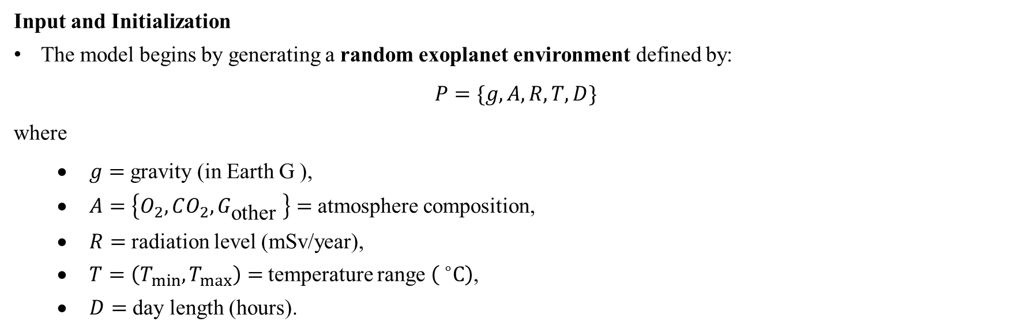
Optimization Problems
Exoplanetary Adaptation Simulation by Genetic Algorithm (GA)
Input and Initialization
The model begins by generating a random exoplanet environment defined by:
$$P=\{g,A,R,T,D\}$$
where
$g=$ gravity (in Earth G ),
$A=\left\{O_{2},CO_{2},G_{\text{other} }\right\}=$ atmosphere composition,
$R=$ radiation level (mSv/year),
$T=\left(T_{min},T_{max}\right)=$ temperature range $\left( ^{∘}C\right)$,
$D=$ day length (hours).

Slide 15
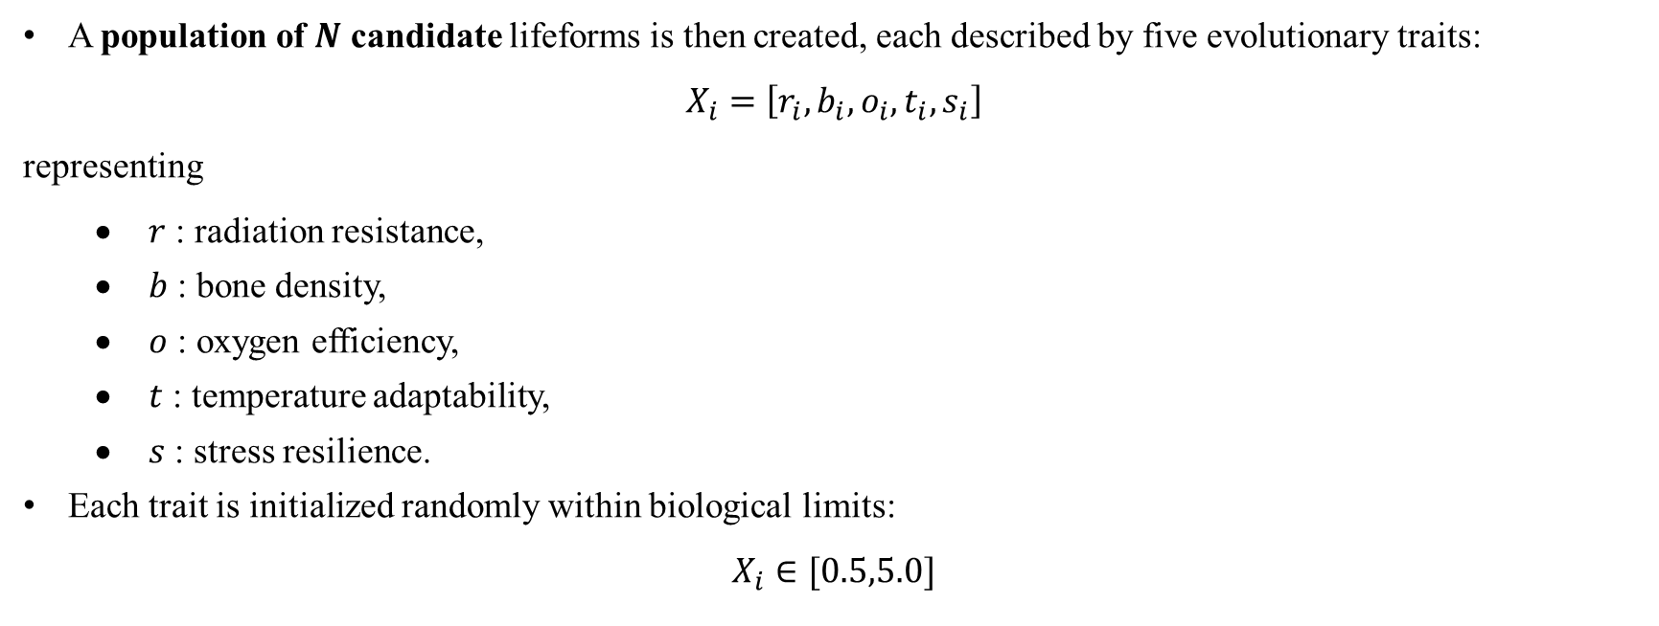
Optimization Problems
Exoplanetary Adaptation Simulation by Genetic Algorithm (GA)
A population of $N$ candidate lifeforms is then created, each described by five evolutionary traits:
$$X_{i}=\left[r_{i},b_{i},o_{i},t_{i},s_{i}\right]$$
representing
$r$ : radiation resistance,
$b$ : bone density,
$o$ : oxygen efficiency,
$t$ : temperature adaptability,
$s$ : stress resilience.
Each trait is initialized randomly within biological limits:
$$X_{i}∈[0.5,5.0]$$

Slide 16
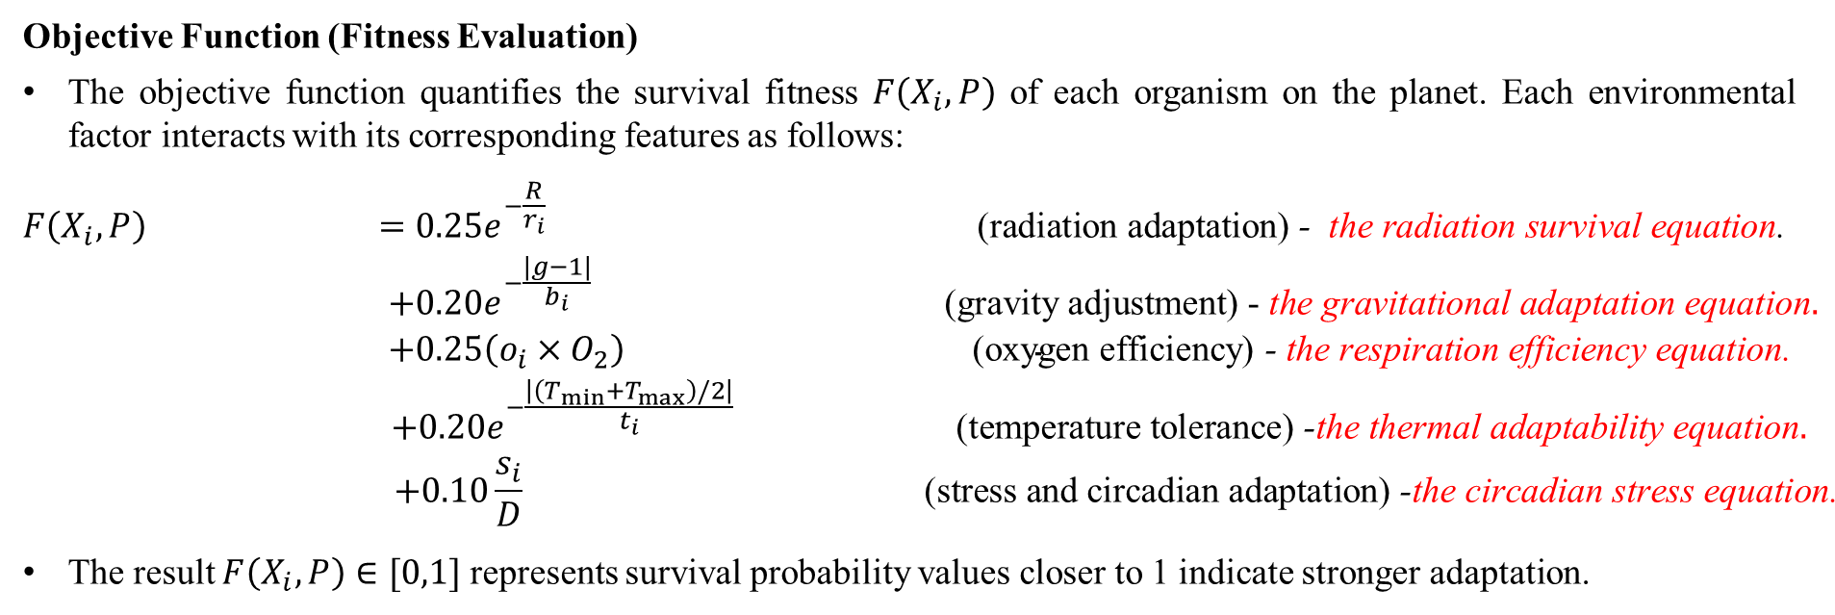
Optimization Problems
Exoplanetary Adaptation Simulation by Genetic Algorithm (GA)
Objective Function (Fitness Evaluation)
The objective function quantifies the survival fitness $F\left(X_{i},P\right)$ of each organism on the planet. Each environmental factor interacts with its corresponding features as follows:
$$\begin{matrix}F\left(X_{i},P\right) & =0.25e^{−\frac{R}{r_{i}}} & & & \text{(}\text{radiation} \text{adaptation}\text{)}\text{ − } \text{the} \text{radiation} \text{survival} \text{equation}\text{.} \\ & +0.20e^{−\frac{|g−1|}{b_{i}}} & & & \text{(}\text{gravity} \text{adjustment}\text{) − }\text{the} \text{gravitational} \text{adaptation} \text{equation}. \\ & +0.25\left(o_{i}×O_{2}\right) & & & \text{(}\text{oxygen} \text{efficiency}\text{)}\text{ − }\text{the} \text{respiration} \text{efficiency} \text{equation}\text{.} \\ & +0.20e^{−\frac{\left|\left(T_{min}+T_{max}\right)/2\right|}{t_{i}}} & & & \text{(}\text{temperature} \text{tolerance}\text{)}\text{ −}\text{the} \text{thermal} \text{adaptability} \text{equation}. \\ & +0.10\frac{s_{i}}{D} & & & \text{(}\text{stress} \text{and} \text{circadian} \text{adaptation}\text{)}\text{ −}\text{the} \text{circadian} \text{stress} \text{equation}\text{.}\end{matrix}$$
The result $F\left(X_{i},P\right)∈[0,1]$ represents survival probability values closer to 1 indicate stronger adaptation.

Slide 17
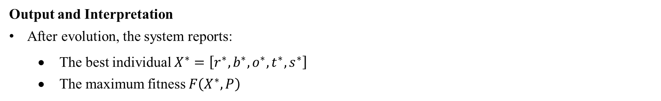
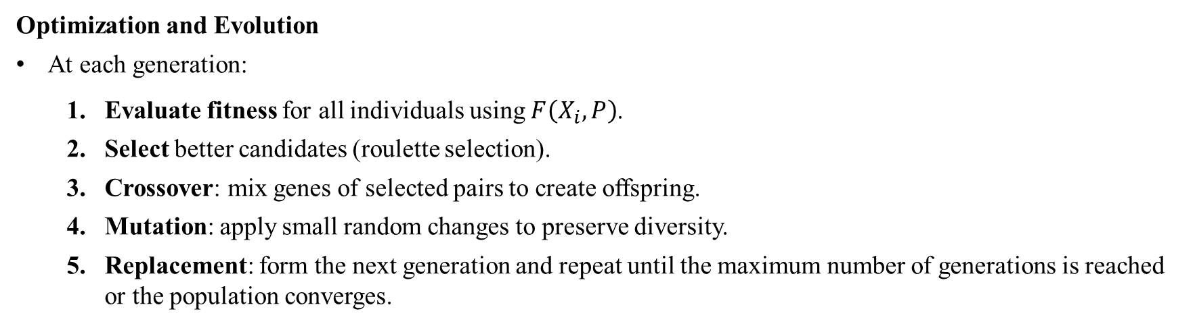
Optimization Problems
Exoplanetary Adaptation Simulation by Genetic Algorithm (GA)
Optimization and Evolution
At each generation:
Evaluate fitness for all individuals using $F\left(X_{i},P\right)$.
Select better candidates (roulette selection).
Crossover: mix genes of selected pairs to create offspring.
Mutation: apply small random changes to preserve diversity.
Replacement: form the next generation and repeat until the maximum number of generations is reached or the population converges.
Output and Interpretation
After evolution, the system reports:
The best individual $X^{∗}=\left[r^{∗},b^{∗},o^{∗},t^{∗},s^{∗}\right]$
The maximum fitness $F\left(X^{∗},P\right)$

